Slide 1
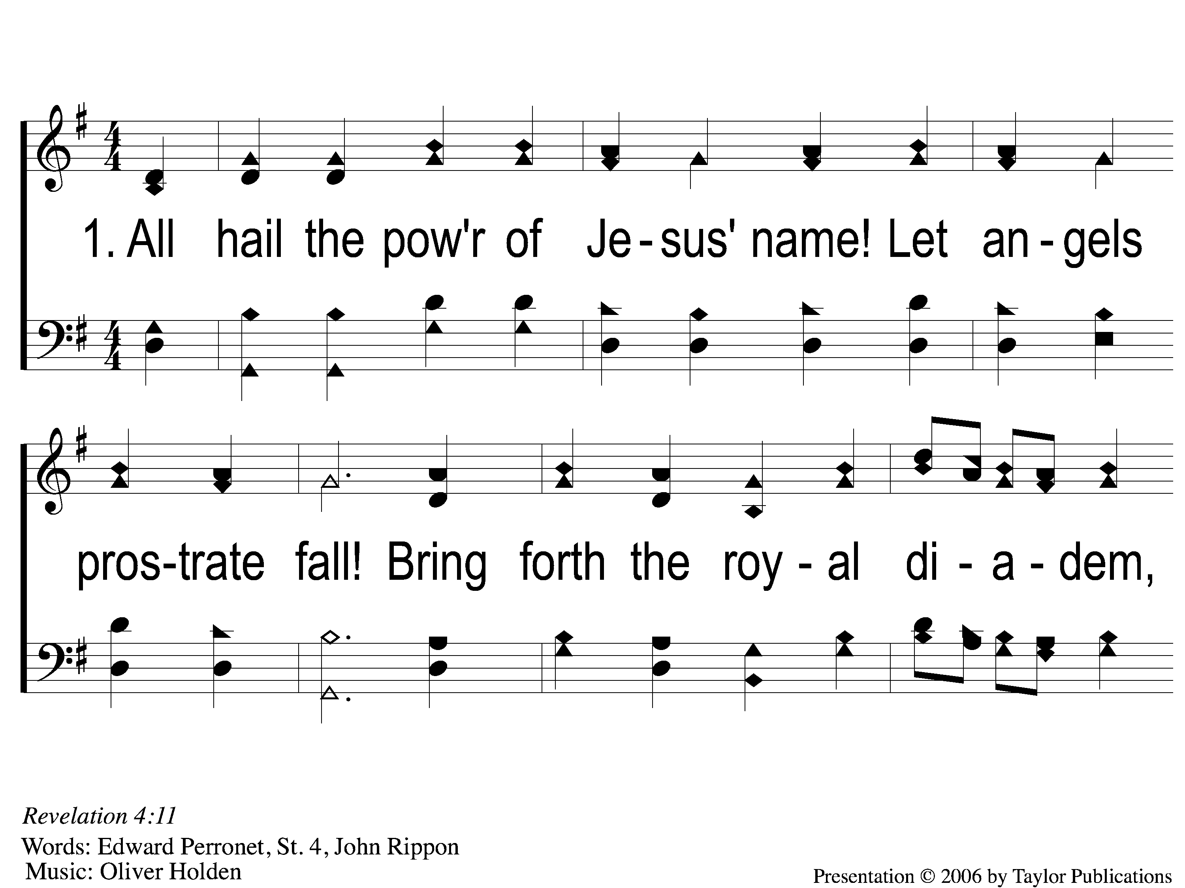
1-1 All Hail the Power of Jesus’ Name
All Hail the Power of Jesus’ Name
162

Slide 2
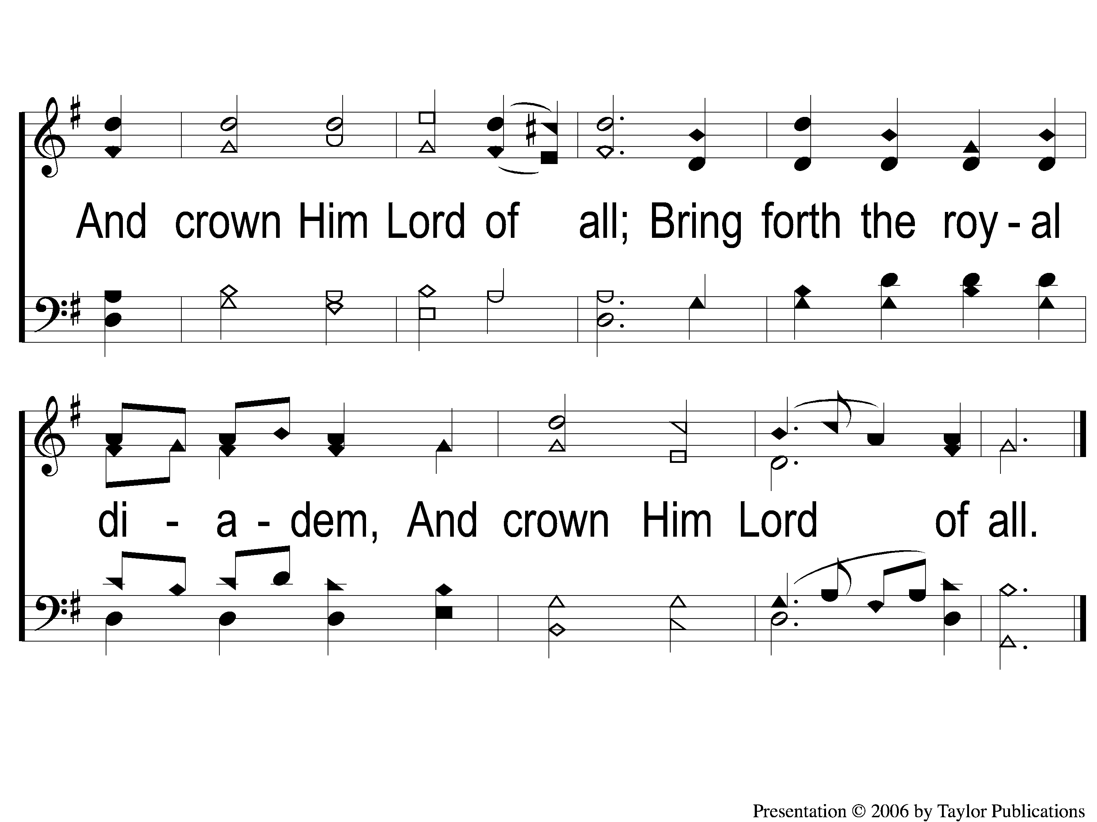
1-2 All Hail the Power of Jesus’ Name
All Hail the Power of Jesus’ Name
162

Slide 3
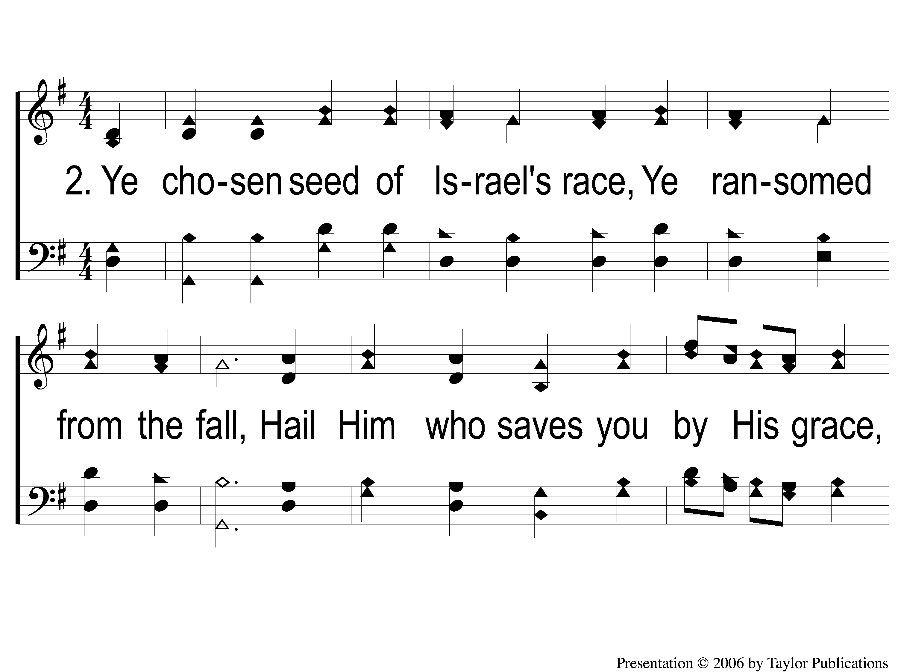
2-1 All Hail the Power of Jesus’ Name
All Hail the Power of Jesus’ Name
162

Slide 4
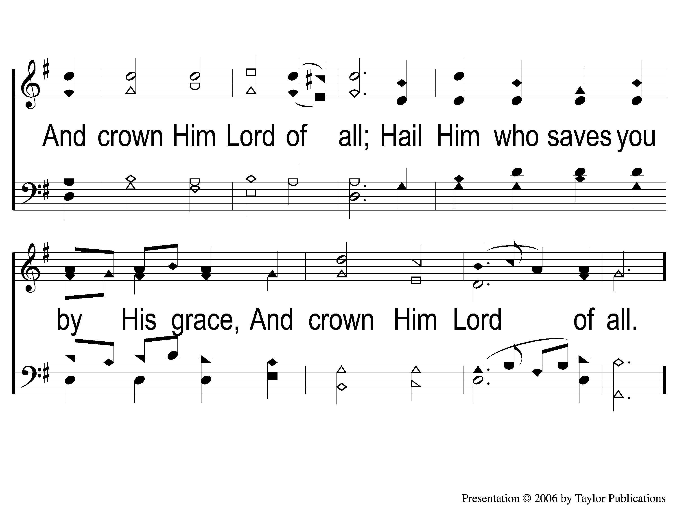
2-2 All Hail the Power of Jesus’ Name
All Hail the Power of Jesus’ Name
162

Slide 5
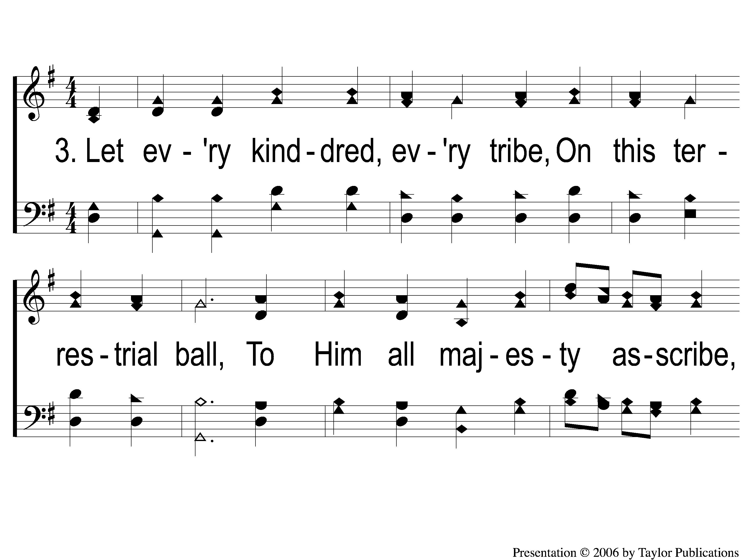
3-1 All Hail the Power of Jesus’ Name
All Hail the Power of Jesus’ Name
162

Slide 6
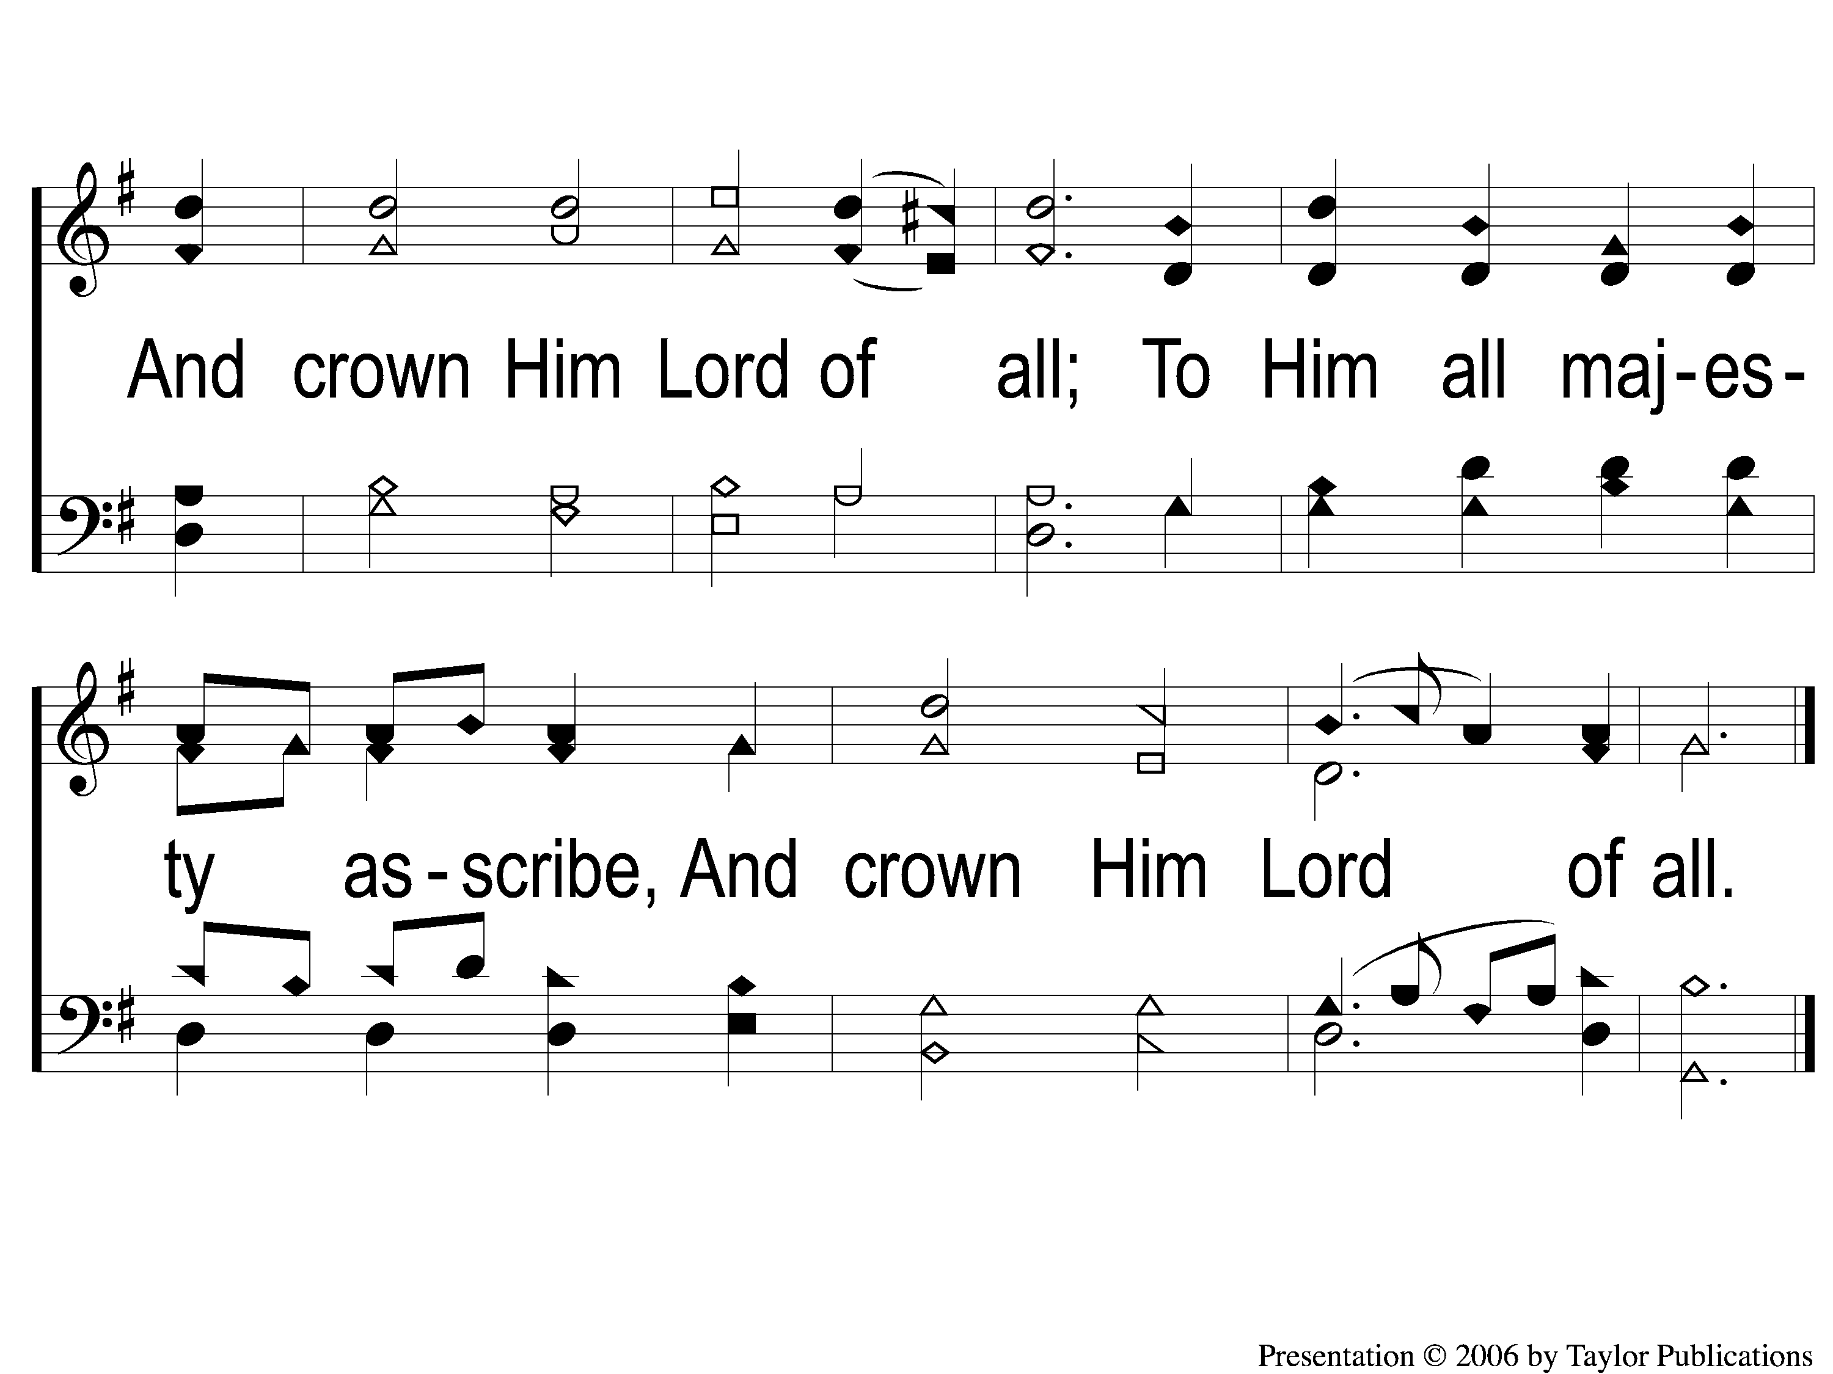
3-2 All Hail the Power of Jesus’ Name
All Hail the Power of Jesus’ Name
162

Slide 7
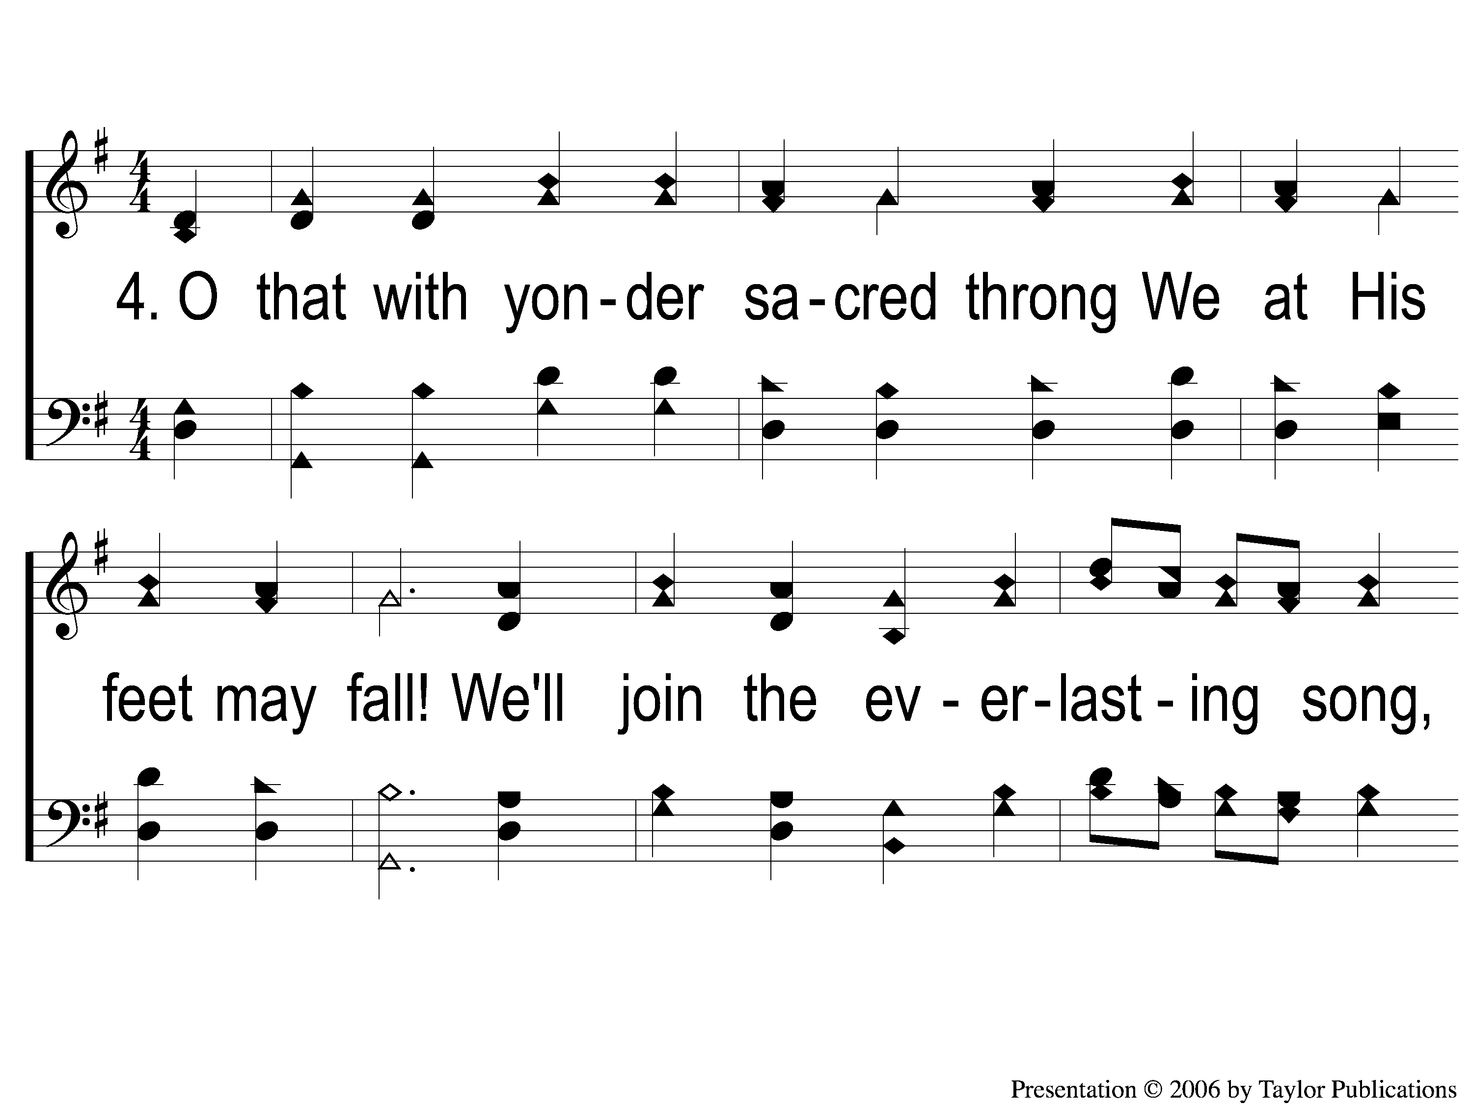
4-1 All Hail the Power of Jesus’ Name
All Hail the Power of Jesus’ Name
162

Slide 8
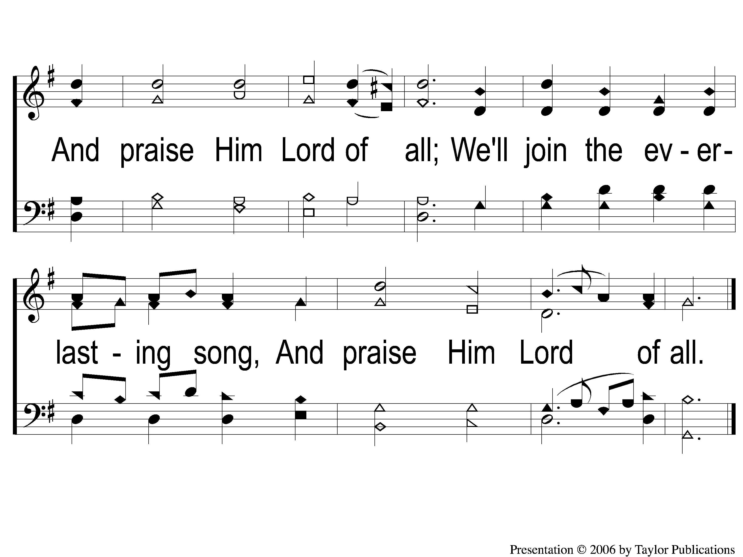
4-2 All Hail the Power of Jesus’ Name
All Hail the Power of Jesus’ Name
162

